Slide 1
CHEMICAL SYNTHESIS
Green Chemistry
The principles developed by chemists and the chemical industry to enact a more sustainable industry. The commonly accepted principles of green chemistry include:
Prevention – preventing waste is easier than cleaning it up.
Atom economy – maximise the incorporation of all materials used during the process into the final product.
Less hazardous chemical synthesis – generating little or no toxic products or by-products.
Designing safer chemicals – chemical products designed to affect their desired function only.

Slide 2
Safer solvents and auxiliaries – these should be made unnecessary wherever possible and innocuous.
Design for energy efficiency – energy requirements should be minimised.
Use of renewable feedstocks – raw materials should be renewable.
Reduce derivatives – keep process as simple as possible.
Catalysis – as selective as possible (preferable to stoichiometric reagents).
Design for degradation – products breakdown safely at the end of their use.
Real-time analysis for pollution prevention – minimise pollution and hazardous substances.
Inherently safer chemistry for accident prevention – process chosen to minimize the potential for accidents.

Slide 3
In general, chemical processes are optimised to maximise the yield (amount of product) and rate. This will often require the application of collision theory, equilibria chemistry and catalysts (including enzymes which can eliminate potential side reactions).
Biofuels
Biofuels (such as bioethanol and biodiesel) are produced from biomass.
They are derived from renewable resources
Natural products with limited health or environmental impact
CO₂ production is balanced (CO₂ absorbed by plants is released when biomass is used)
Biofuels produce less particulate emissions

Slide 4
Ethanol
Two methods for producing ethanol
Synthesis by Fermentation (Greener Method)
Accounts for 93% of world ethanol production
Relies on yeast that produce enzymes which catalyse plant (e.g. corn ,wheat, sugar cane, potatoes, etc) carbohydrates (e.g. sugar, starch, etc) into ethanol
Most ethanol produced is used for motor fuel or a fuel blend.
Two major reactions are hydrolysis of sucrose to glucose and fructose (catalysed by the yeast enzyme invertase or sucrase) and fermentation of glucose/fructose mixture to produce ethanol and carbon dioxide (catalysed by the yeast enzyme zymase).

Slide 5
Hydrolysis of Sucrose:
Fermentation:
Overall:

Slide 6
Specific conditions chosen depends on nature of yeast chosen and feedstock used.
Enzymes are protein molecules which are biological catalysts.
They speed up reaction rates by producing an alternate reaction pathway that has a lower activation energy hence more particles have sufficient kinetic energy to meet the new required activation energy. This increases the frequency of successful collisions and, as a result, reaction rate.
Most tend to be very specific (enzyme specificity) in the reactions they catalyse.
Their complex structure and shape allows a reactant molecule (substrate) to fit onto a specific active site on the enzyme through weak intermolecular forces.

Slide 7
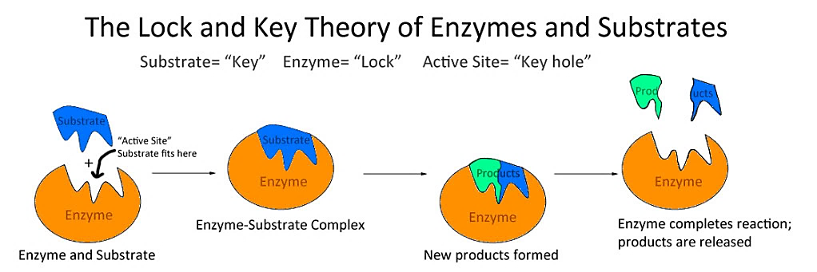
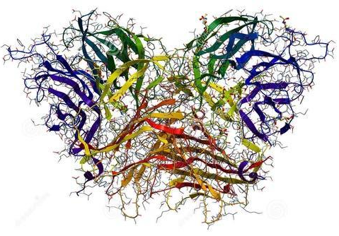
Whilst in position, bonds are more easily rearranged, producing new products.
Typically referred to as the lock and key model.
Invertase Enzyme
(Wikianswers n.d.)
https://www.youtube.com/watch?v=qgVFkRn8f10
(Intermesh, n.d.)

Slide 8
Due to enzyme specificity, there is less chance of side reactions and unwanted by-products being formed in industrial processes.
Enzymes are specific to both temperature and pH. These conditions can affect conformation and effectiveness. They are said to be denatured (structure and shape are altered) if pH and temperature conditions are not correct.
When a catalyst is present reaction rate increases to a point if the concentration of a reactant is increased (due to limited active sites being available).

Slide 9
As fermentation is an exothermic process, cooling is required to prevent denaturing of the enzymes involved. A slightly acidic pH (3 – 5) is typically chosen.
During the initial phase of fermentation, yeast grows and reproduces rapidly. It respires aerobically and quickly uses up all oxygen available. If the reaction vessel is sealed, this then causes anaerobic respiration to take place (whereby glucose is converted to ethanol).
Nutrients (e.g. diammonium hydrogenphosphate) may also be added to promote the growth and reproduction of the yeast.
At around 8 – 14% ethanol concentration, the yeast are killed off by alcohol poisoning. They are removed and the mixture distilled to produce 95% ethanol.

Slide 10
Synthesis from Ethene
Quicker method using acid catalysed addition reaction of water and ethene (can be part of petroleum production and refining process).
Involves passing steam and ethene through a catalyst bed made of silica particles coated with pure phosphoric acid as the catalyst.
CH₂=CH_{2(g)} + H₂O_{(g)} ⇌ CH₃CH₂OH_{(g)} ΔH = ‒45 kJ
Temperature of around 300 ºC and pressure of 6 – 7 MPa used
H₃PO₄

Slide 11
At a high temperature, reaction rate is increased because the average kinetic energy of the reactant particles is increased. This means a greater proportion of reactant particles now have sufficient kinetic energy to meet the activation energy required to react. This increases the frequency of successful collisions. The velocity of the particles also increases which results in a greater rate of collisions and so increases (to a lesser degree) the reaction rate.
At an increased temperature, the rate of the forward and reverse reactions increase. The rate of the endothermic reaction is increased more than the exothermic reaction which in this case, is the reverse reaction. This means a lesser yield of ethanol would be produced at a higher temperature (i.e. equilibrium will shift left). As such a compromise of 300 ºC is used to ensure a sufficient yield at an acceptable reaction rate.

Slide 12
At a higher pressure, the reaction rate increases due to an increased frequency of collisions (due to less distance between particles) and the yield also increases due to a greater number of particles being present on the reactant side in the forward reaction (i.e. equilibrium shifts to the right).
Catalyst also increases the reaction rate but has no effect on yield.
Molar ratio of ethene to water used is 1:0.6 as at 1:1 steam dilutes and washes away H₃PO₄.
Under these conditions 5% conversion occurs so ethanol is separated and the mixture repeatedly passed over the catalyst so that an overall yield of 95% is achieved.

Slide 13
Biodiesel
Contains methyl or ethyl esters
Produced almost solely through base catalysed trans-esterification of triglycerides found in natural oils and fats.
https://www.youtube.com/watch?v=zj6fDDQrl3w
(R tends to be between 8 – 21 carbon atoms)
(Bad feedstock)
(Good biodiesel product)
(Good feedstock)

Slide 14
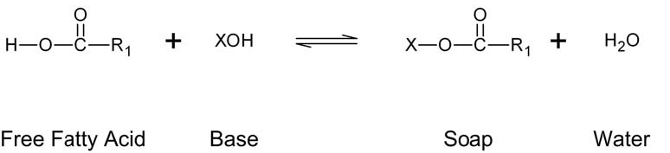
Feedstock is filtered and treated to remove any water and free fatty acids.
Free fatty acids can produce soap (carboxylate ion) by reacting with base. This soap then emulsifies with biodiesel making it difficult to extract.
If there is significant free fatty acids present in the feedstock, they must be treated with methanol and H₂SO₄ catalyst to convert them to methyl esters.
Free fatty acid - bad
Biodiesel - good

Slide 15

Water can also react with biodiesel (a long chain ester) to reverse the esterification reaction to produce alcohol and carboxylic acid.
Once water and free fatty acids are removed the oil can then undergo transesterification to produce biodiesel through reacting the triglyceride with methanol in a sealed vessel (to prevent loss of methanol). Methanol is added in a large excess to increase the equilibrium yield of biodiesel.
(NA, 2019)

Slide 16
A NaOH or KOH catalyst is used to increase the reaction rate as is a moderate temperature (60 ºC).
(triglyceride) (methyl ester – biodiesel)(glycerol)
https://www.youtube.com/watch?v=NPF6vdfLHlU
The biodiesel and glycerol form two separate layers. The biodiesel (top layer – less dense) is washed with warm water and dried ready for use.

Slide 17
A greener method involves using lipases (a group of enzymes) in place of the base catalyst.
Advantages of using lipases
Milder temperature (less energy required) and pH conditions.
Can tolerate feedstocks high in free fatty acids (no need to pre-treat).
Can simultaneously catalyse transesterification and esterification of free fatty acids.
No side reactions.

Slide 18
Impediments to using lipases
Slower reaction rate (higher concentration needed).
Expensive.
Recovery from final mixture is difficult (may be overcome by binding lipase onto a solid particle surface).
High concentration of alcohol inhibits its use.
Haber Process
Produces ammonia on an industrial scale (which can be used to produce fertilisers, polymers, explosives and cleaning agents).

Slide 19
Reaction given by:
N_{2(g)} + 3H_{2(g)} ⇌ 2NH_{3(g)} ΔH = ‒92 kJ
Condition – Increase temperature
Effect on reaction rate – Increased
Explanation – Increased average kinetic energy means a greater proportion of collisions have sufficient energy to meet activation energy required. This increases the frequency of successful collisions which increases reaction rate (also increased velocity means greater frequency of collisions).

Slide 20
Effect on yield – Decreased
Explanation – Increased temperature increases the rate of both forward and reverse reactions. The endothermic reaction is increased more which, in this case is the reverse reaction. This means the reverse reaction rate is now greater relative to the forward reaction rate and so the yield of NH₃ is reduced.
Compromise – Use 350 – 550 ºC. Moderate temperature ensures acceptable yield at reasonable rate.

Slide 21
Reaction given by:
N_{2(g)} + 3H_{2(g)} ⇌ 2NH_{3(g)} ΔH = ‒92 kJ
Condition – Increase pressure
Effect on reaction rate – Increased
Explanation – Decreased distance between particles increases the frequency of successful collisions which increases the reaction rate.

Slide 22
Effect on yield – Increased
Explanation – Decreasing the distance between the particles increase the frequency of successful collisions which increases the rate of both the forward and reverse reactions. As the ratio of reactants to products is 4:2, the forward reaction rate will increase more than the reverse. This results in an increased yield of NH₃.
Compromise – Use 15 – 35 MPa. The pressure is limited by dangers associated with operating at high pressures and cost of specialised machinery and generating high pressures.

Slide 23
Reaction given by:
N_{2(g)} + 3H_{2(g)} ⇌ 2NH_{3(g)} ΔH = ‒92 kJ
Condition – Add catalyst
Effect on reaction rate – Increased
Explanation – Provides an alternate reaction pathway that has a lower activation energy so a greater proportion of collisions have sufficient energy to meet activation energy required.

Slide 24
Effect on yield – No impact
Explanation – Rates of forward and reverse reactions are increased equally.
Compromise – Use a FeFe₂O₄ / MgO / Al₂O₃ / SiO₂ catalyst to increase the reaction rate (only).

Slide 25
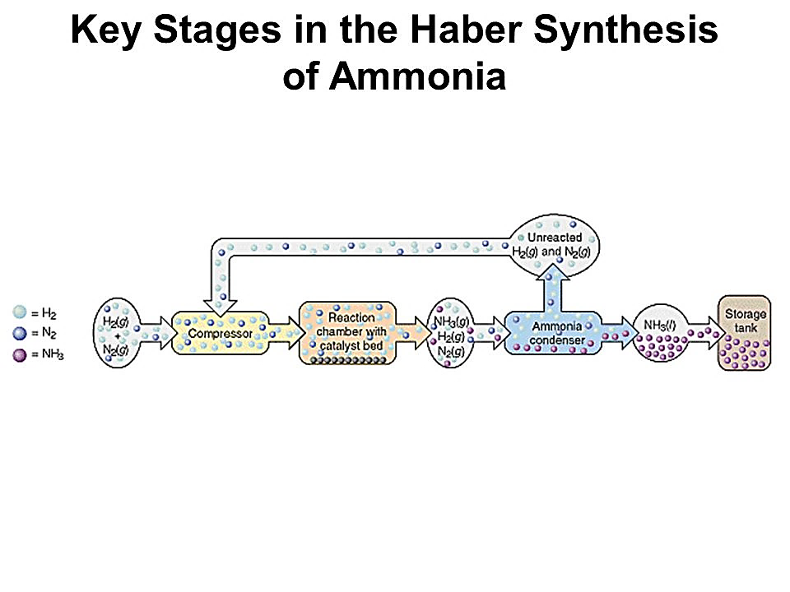
The ammonia produced (with a yield of 15 – 30%) is condensed so that the ammonia is liquefied and can be drained off whilst the remaining N_{2(g)} and H_{2(g)} can be recycled. How can the NH_{3(g)} be liquefied and the N_{2(g)} and H_{2(g)} remain gaseous?
NH_{3(g)} possesses the stronger intermolecular forces of hydrogen bonding, dipole-dipole and dispersion forces whilst N_{2(g)} and H_{2(g)} possess only dispersion forces. As such, NH_{3(g)} has a higher boiling point and will liquefy first.
(Reder n.d.)

Slide 26
N_{2(g)} is obtained from the atmosphere but H_{2(g)} is produced through two reactions:
(steam reforming) CH_{4(g)} + H₂O_{(g)} ⇌ CO_{(g)} + 3H_{2(g)} ∆H = +206 kJ
(‘shift’ reaction) CO_{(g)} + H₂O_{(g)} ⇌ H_{2(g)} + CO_{2(g)} ∆H = −41 kJ
Contact Process
Produces sulfuric acid on an industrial scale (which can be used to produce fertilisers, detergents, other acids, polymers, explosives and used in metal extraction).
First stage: Production of sulfur dioxide
S_{(l)} + O_{2(g)} → SO_{2(g)} ΔH = ‒297 kJ

Slide 27
Some sulfuric acid plants are integrated into metal sulfide smelting plants to use the waste SO_{2(g)} produced rather than burning S_{(l)}.
Second stage: Conversion of sulfur dioxide to sulfur trioxide
2SO_{2(g)} + O_{2(g)} ⇌ 2SO_{3(g)} ΔH = ‒198 kJ

Slide 28
Reaction given by:
2SO_{2(g)} + O_{2(g)} ⇌ 2SO_{3(g)} ΔH = ‒198 kJ
Condition – Increase temperature
Effect on reaction rate – Increased
Explanation – Increased average kinetic energy means a greater proportion of collisions have sufficient energy to meet activation energy required. This increases the frequency of successful collisions which increases reaction rate (also increased velocity means greater frequency of collisions).

Slide 29
Effect on yield – Decreased
Explanation – Increased temperature increases the rate of both forward and reverse reactions. The endothermic reaction is increased more which, in this case is the reverse reaction. This means the reverse reaction rate is now greater relative to the forward reaction rate and so the yield of SO₃ is reduced.
Compromise – Use 450 ºC. Moderate temperature ensures acceptable yield at reasonable rate.

Slide 30
Reaction given by:
2SO_{2(g)} + O_{2(g)} ⇌ 2SO_{3(g)} ΔH = ‒198 kJ
Condition – Increase pressure
Effect on reaction rate – Increased
Explanation – Decreased distance between particles increases the frequency of successful collisions which increases the reaction rate.

Slide 31
Effect on yield – Increased
Explanation – Decreasing the distance between the particles increase the frequency of successful collisions which increases the rate of both the forward and reverse reactions. As the ratio of reactants to products is 3:2, the forward reaction rate will increase more than the reverse. This results in an increased yield of SO₃.
Compromise – Use 100 – 200 kPa. Pressure is limited by cost of specialised machinery and generating high pressures which substantially eats away at profit margin. Yield is also ordinarily very high.

Slide 32
Reaction given by:
2SO_{2(g)} + O_{2(g)} ⇌ 2SO_{3(g)} ΔH = ‒198 kJ
Condition – Add catalyst
Effect on reaction rate – Increased
Explanation – Provides an alternate reaction pathway that has a lower activation energy so a greater proportion of collisions have sufficient energy to meet activation energy required.

Slide 33
Effect on yield – No impact
Explanation – Rates of forward and reverse reactions are increased equally.
Compromise – Use a V₂O₅ catalyst to increase the reaction rate (only).

Slide 34
Reaction given by:
2SO_{2(g)} + O_{2(g)} ⇌ 2SO_{3(g)} ΔH = ‒198 kJ
Condition – Remove SO_{3(g)} product
Effect on reaction rate – No change
Explanation – Removing product does not impact reaction rate.

Slide 35
Effect on yield – Increased
Explanation – As partial pressure of SO_{3(g)} is reduced, this increases the distance between SO_{3(g)} particles which decreases the frequency of successful collisions between them. This decreases the rate of reverse reaction relative to forward reaction. As the forward reaction rate is now greater relative to the reverse reaction, the yield of SO_{3(g)} is increased.
Compromise – Product is continually removed.

Slide 36
Stage three: Conversion of sulfur trioxide to sulfuric acid
(oleum production) H₂SO_{4(l)} + SO_{3(g)} → H₂S₂O_{7(l)}
(water added) H₂S₂O_{7 (l)} + H₂O_{(l)} → 2H₂SO_{4(l)}
(overall) H₂O_{(l)} + SO_{3(g)} → H₂SO_{4(l)}
SO_{3(g)} is not added directly to water to produce H₂SO_{4(l)} as this is a highly exothermic reaction and would produce a highly corrosive mist of concentrated H₂SO_{4(l)}.

Slide 37
Manufacture of Ethyl Ethanoate
Ethyl ethanoate is a very useful, non-toxic solvent.
Produced through the esterification of ethanoic acid with ethanol with a sulfuric acid catalyst (Fisher esterification reaction).
Excess of the cheaper ethanol is used to maximise the yield. The ethanol can be produced through the acid catalysed addition reaction of ethene and water.
The reaction produces a yield of 65% at a temperature of 25 ºC.
Yield is increased up to 95% by continually removing the products.

Slide 38
Quantities in Chemical Synthesis
In general, stoichiometric quantities are used in synthesising specific products (although on an industrial scale, the cheaper reactant is often in excess).
Where equilibrium reactions are involved, yields of 100% may not be economically viable. Nevertheless, companies will always try to maximise yields in order to increase profit margins. Yields can be affected by:
Loss of reagent through side reactions
Loss of product
Incomplete reaction
Presence of impurities

Slide 39
% yield can be calculated using the formula:
Example: Calculate the percentage yield of sulfuric acid produced through the Contact process if 1.089 ×10³ L of H₂SO₄ is produced when 3.253 ×10⁵ g of sulfur is reacted with an initial 3.408 ×10⁵ g of oxygen gas (H₂SO₄ has a density of 1.840 g mL⁻¹).
S_{(l)} + O_{2(g)} → SO_{2(g)}
2SO_{2(g)} + O_{2(g)} ⇌ 2SO_{3(g)}
H₂SO_{4(l)} + SO_{3(g)} → H₂S₂O_{7(l)}
H₂S₂O_{7(l)} + H₂O_{(l)} → 2H₂SO_{4(l)}
(When adding these equations together you must take into account you are also adding H₂SO₄ as a new reactant along the line (i.e. do not remove/cancel them out at the end))

Slide 40
n(S) = (3.253 ×10⁵)/32.06 n(O₂) = (3.408 ×10⁵)/32.00
= 10146.6 mol = 10650 mol
Compare n(S) = 10146.6/1 Compare n(O₂) = 10650/1
= 10146.6 mol = 10650 mol
S is limiting reagent as it is present less on a mole to mole basis.
n(SO₂) = n(S) = 10146.6 mol
n(SO₃) = n(SO₂) = 10146.6 mol
n(H₂S₂O₇) = n(SO₃) = 10146.6 mol
n(H₂SO₄) = 2 ×n(H₂S₂O₇) = 20293.2 mol
m(H₂SO₄) = (20293.2)×98.086 = 1990275.9 g (theoretical yield)

Slide 41
m _{(actual yield)} = ρV
= ((1.840) x (1 ×10³)) x (1.089 ×10³)
= 2003760 g
% yield = (2003760/ 1990275.9) ×100
= 100.7 % (i.e. product is impure)
Soaps and Detergents
Heating an ester with a strong base causes its hydrolysis.

Slide 42
Ester hydrolysis is used to produce soap (process is called saponification).
(triester) soap (sodium stearate) (glycerol)
Soap is able to clean because of its structure. It possesses a long, non-polar hydrocarbon tail and a highly charged anionic (carboxylate ion) head.
Soaps should have at least 13 carbon atoms present.

Slide 43
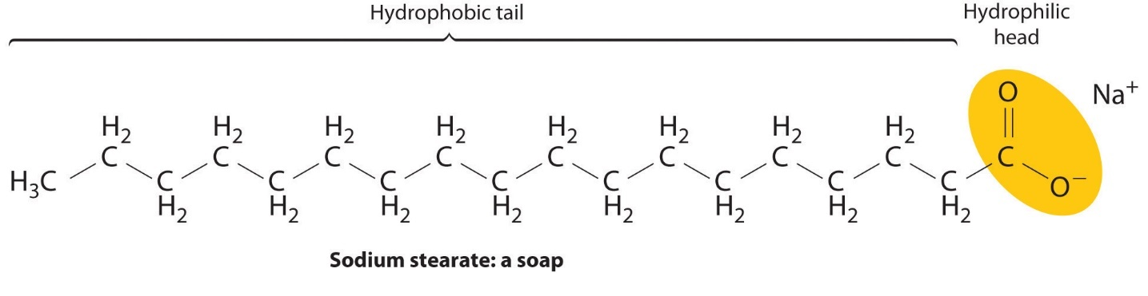
(Konold n.d.)
Soap molecules (or surfactant ions) attach to grease and dirt through dispersion forces between the non-polar (hydrophobic) tail and the non-polar grease. The anionic (hydrophilic) head is attracted to water molecules through ion-dipole interactions. As the soap pulls the grease away from the (for example) fabric, they form spherical structures called micelles.

Slide 44
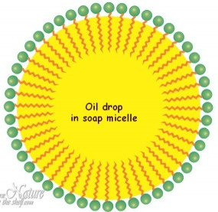
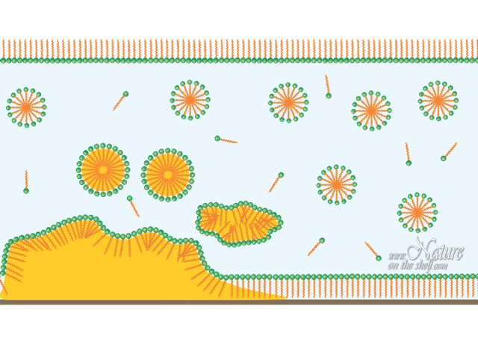
(Natureontheshelf, 2016)
Hot water and agitation further improve the cleaning action of soap.
Hard water (water with a relatively high concentration of calcium and/or magnesium ions) prevents the use of soaps as cleaning agents as the surfactant ions form a precipitate known as scum.

Slide 45
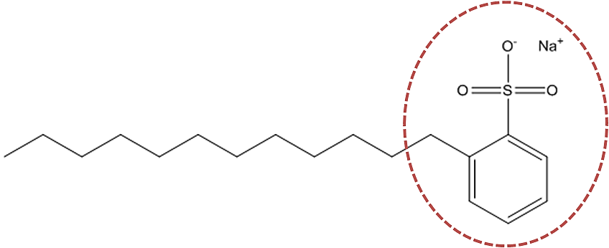
Ca²⁺_{(aq)} + 2CH₃(CH₂)₁₆COO‒_{(aq)} → Ca(CH₃(CH₂)₁₆COO)_{2(s)}
Detergents (synthetic soaps) are similar to soaps but they do not form scum in hard water. They can be produced more cheaply than soaps through the reaction of sulfuric acid with petroleum products. They are also better cleaners than soaps.
Sodium dodecylbenzenesulfonate is a typical anionic detergent.
(Reckitt Benckiser, n.d.)

Slide 46
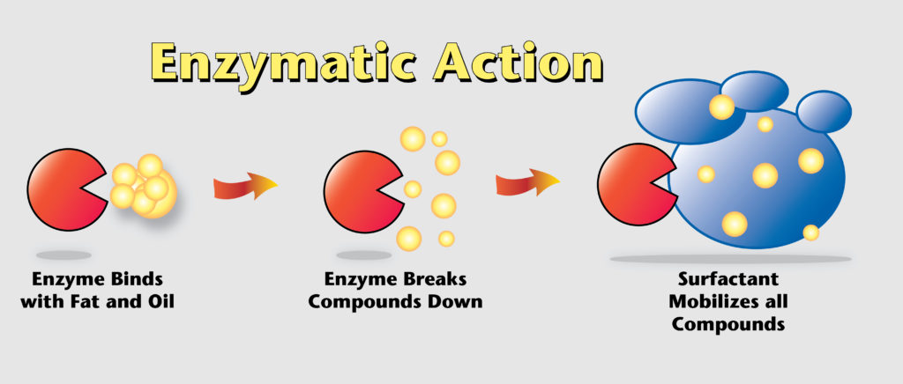
Enzymes (such as lipase and protease) can be used to improve the cleaning effectiveness of soaps and detergents by catalysing the break down of the fats and proteins into smaller molecules which are then more soluble with the soap or detergent.
https://www.youtube.com/watch?v=o8Cj-1WZfOg

Slide 47
Properties and Uses of Polymers
Polyethene (polyethylene) – can be LDPE: has a relatively low melting point, is soft, flexible and insulating, Used for packing film, tubing, bottles, electrical cable insulation and toys. HDPE has a higher melting point, is harder and more rigid. It is used for chopping boards, pipes, toys and crates.
Polytetrafluororethylene (PTFE) – higher strength of C‒F bonds give it a higher chemical resistance than polyethylene (even at higher temperatures). It is non-stick, has a high melting point and high electrical resistance. It is used in cooking pans, coatings on bearings and semi-permeable membranes in fuel cells.

Slide 48
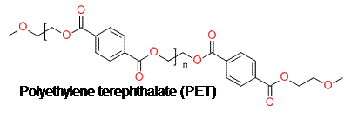
Polyethylene terephthalate (PET) – is a polyester made through the condensation reaction of benzene-1,4-dicarboxylic acid and ethane-1,2-diol. It can interact through dipole-dipole forces which makes it stronger than polyethylene. It is used to make fibres, solar cells, thermal blankets and plastic bottles.
(Huntsman, 2012)

Slide 49
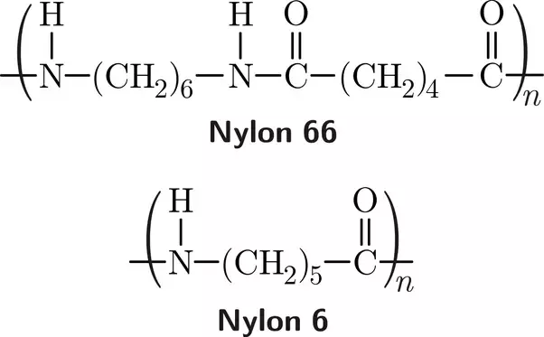
Nylon – is a polyamide made through the condensation polymerisation of hexanedioic acid and hexane-1,6-diamine. The ability of nylon to form hydrogen bonds between the lone pair of electrons on the oxygen in the carbonyl group and the hydrogen from the amine group greatly increases its tensile strength. It is used in clothing, fishing line, rope, carpet, parachutes, seat belts and tents.
(Thankur, 2018)
Notes:
Nylon 66 is made form the two monomers described in the paragraph. Nylon 6 is made from the one monomer (6-aminohexanoic acid).

Slide 50
Characteristics such as cross-linking (when multiple polymers bond together), chain length, branching and intermolecular forces present all affect the properties and, hence, uses, of particular polymers.
Crosslinking effectively makes many polymers into one giant polymer. This improves strength, chemical resistance and raises the melting/boiling point. Usually polymers are crosslinked once they have formed their shape as they cannot be remolded once they are shaped (this means they are thermoset polymers…which makes them very hard to recycle. Thermoplastics are not crosslinked polymers and can be reshaped once molded).

Slide 51
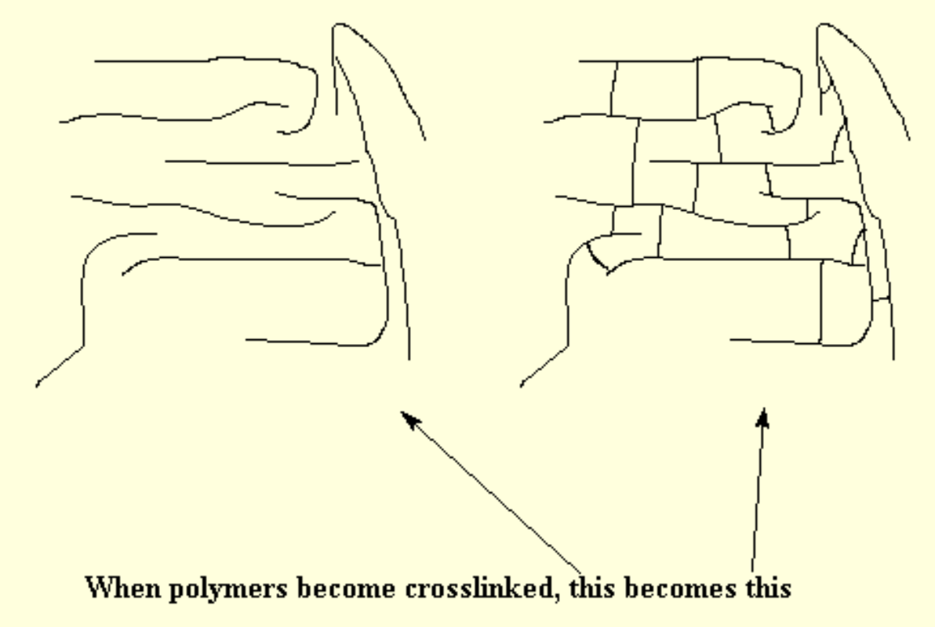
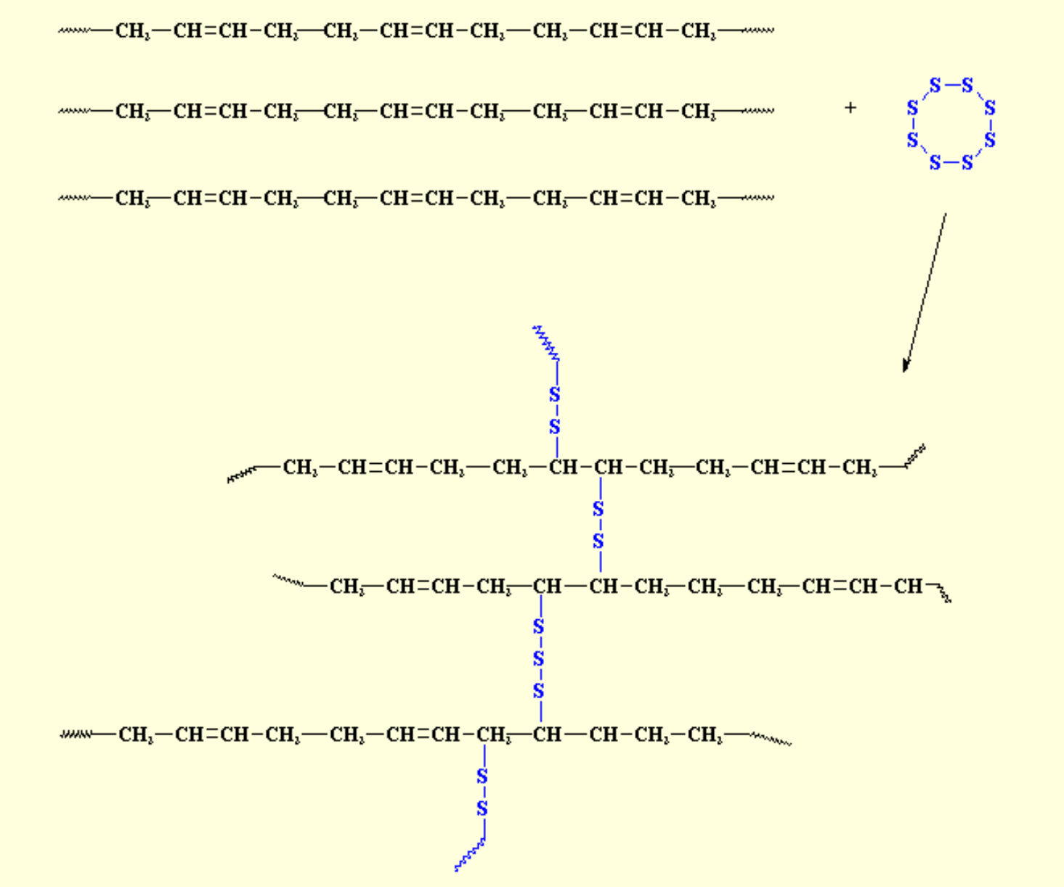
Vulcanised rubber is made by crosslinking rubber molecules with sulfur bridges (links).
(Polymer Science Learning Centre 2003)
(Polymer Science Learning Centre 2003)

Slide 52
In general:
As chain length of polymers increases, the intermolecular forces increase and their strength, rigidity and melting/boiling points increase.
As branching of polymers increases (ie move from high density to low density), the intermolecular forces decrease (due to being unable to come as close together as their unbranched counterparts) and their strength, rigidity and melting/boiling points decrease.

Slide 53
Bibliography
Huntsman, E. (2012). Polyethylene Terephthalate. Retrieved from Sailcloth Science: https://sites.google.com/site/sailclothscience/sailcloths/dacron/synthesis
Intermesh. N.d. “Invertase.” IndiaMART. Accessed 11 August 2020. https://www.indiamart.com/proddetail/invertase-10881342248.html
Konold, C. n.d. "Chem 1010." Education Portfolio. Accessed August 3, 2016. https://catherinekonold.wordpress.com/as-general-education/chem-1010/.
Multi-Clean. 2016. How to Remove Odors Using Bio-Enzymatic. June 30. Accessed September 2021. https://multi-clean.com/eliminate-odors-enzyme-cleaners/.
NA. 2019. “Hydrolysis of Esters.” Chemistry Libretexts. Accessed August 11, 2020. https://chem.libretexts.org/Courses/Eastern_Mennonite_University/EMU%3A_Chemistry_for_the_Life_Sciences_(Cessna)/15%3A_Organic_Acids_and_Bases_and_Some_of_Their_Derivatives/15.09_Hydrolysis_of_Esters
Natureontheshelf. 2016. "How Soap Works." Nature on The Shelf. Accessed August 3, 2016. http://www.natureontheshelf.com/soap-making/how-soap-works.html.
Nizalowski, I. n.d. "Explore Secret Stuff, Nerd Jokes and More!" Pinterest. Accessed August 3, 2016. https://au.pinterest.com/pin/328622104030498130/.
Onsdag. 2015. "Week 52." B and K Technologists. Accessed August 3, 2016. http://www.ksek.se/en-GB/student_-26268260.
Reckitt Benckiser. n.d. "Greasy Stains." Chemistry inYour Cupboard. Accessed August 3, 2016. http://www.rsc.org/learn-chemistry/resources/chemistry-in-your-cupboard/vanish/9.
Reder, C. n.d. "Chapter 6 Chemical Equilibrium." Slide Player. Accessed August 3, 2016. http://slideplayer.com/slide/4213696/.
Sptcard.com. 2016. "sptcard.com." Soda Pun Jokes. Accessed August 3, 2016. http://www.sptcard.com/soda/soda-pun-jokes
Thakur, A. (2018, February 13). Why are Nylon 6, Nylon 6,6 and Nylon 6,10 Called That? Retrieved from Quora: https://www.quora.com/Why-are-Nylon-6-Nylon-6-6-and-Nylon-6-10-called-that
Vignesh. n.d. "Chemistry Expectations." Amulyam. Accessed August 3, 2016. http://www.amulyam.in/funny-pics-chemistry-expectations-117084.
Wanelo. 2016. "Chemistry Puns." Wanelo. Accessed August 3, 2016. https://wanelo.com/shop/chemistry-puns.
Wikianswers. n.d. "What Do Enzymes and Substrates Look Like." Answers.com. Accessed August 3, 2016. http://www.answers.com/Q/Why_is_an_enzyme_called_lock_and_key_model?#slide=1.

